Slide 1
Course Introduction
(Lecture-only)
Prof. Dr. Dirk Riehle
Friedrich-Alexander University Erlangen-Nürnberg
COSS A01
Licensed under CC BY 4.0 International
Notes:
It is Friedrich-Alexander University Erlangen-Nürnberg – FAU, in short.
Corporate identity wants us to say “Friedrich-Alexander University”.

Slide 2
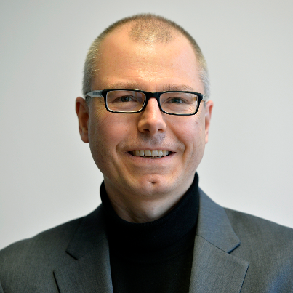

Professorship of Open Source Software
Professor of Computer Science
  For software engineering and open source software
  At the computer science department of the engineering faculty
Previously held research positions at ...
  SAP Labs (Silicon Valley) leading the open source research group
  UBS (Swiss Bank, Zurich) leading the software engineering group
Previously worked in development at ...
  Skyva Inc. (supply chain software, Boston) as software architect
  Bayave GmbH (on-demand business software, Berlin) as CTO
Researches and teaches commercial open source at
  Friedrich-Alexander-University Erlangen-Nürnberg
  Affiliated with CROSS at University of California, Santa Cruz
Ph.D. from ETH Zurich, M.B.A. from Stanford GSB

Slide 3
Course Learning Goals
Understand ...
  The software industry and its players
  Commercial open source startups
  How to spin-out from a university

Slide 4
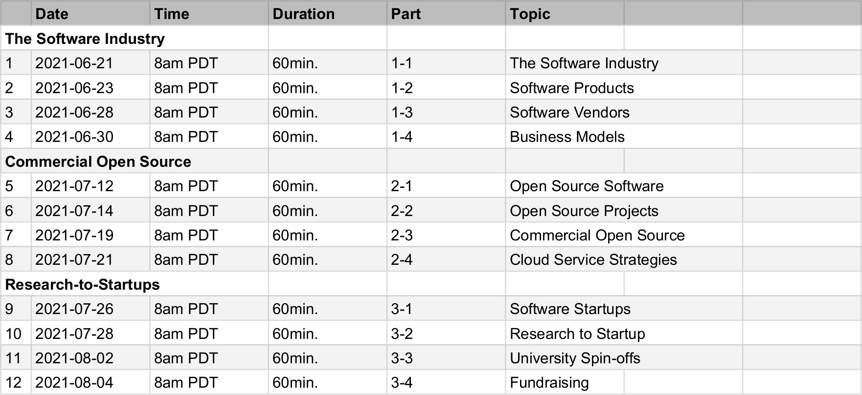
Course Content
The software industry
  The software industry
  Software products
  Software vendors
  Business models
Commercial open source
  Open source software
  Open source projects
  Commercial open source
  Cloud computing strategies
University spin-offs
  Software startups
  Research vs. startup
  The university spin-off
  Fundraising

Slide 5
Practitioner Literature Base of the Course
Business Model
Canvas [1]
The Lean
Startup [2]
Customer
Development [3]
Agile
Development
With cleaned-up terminology, and as applied to commercial open source
[1] Osterwalder, A. & Pigneur, Y. (2010). Business Model Generation.
[2] Ries, E. (2011). The Lean Startup.
[3] Blank, S., & Dorf, B. (2012). The Startup Owner’s Manual.

Slide 6
Skills Required for Course
Required ...
  Basic business understanding
Familiar with ...
  N/A

Slide 7
Thank you! Questions?
dirk.riehle@fau.de – https://oss.cs.fau.de
dirk@riehle.org – https://dirkriehle.com – @dirkriehle
DR

Slide 8
Credits and License
Original version
  © 2021 Dirk Riehle, some rights reserved
  Licensed under Creative Commons Attribution 4.0 International License
Contributions
  None yet

